Slide 1

Neucent Technologies Private Limited

Slide 2
About NEUCENT TECHNOLOGIES:
Established in 2021 Neucent Technologies Pvt. Ltd. Leading Provider of Mobile and Web Development Solutions Specializing in Native & Cross-Platform Technologies, AWS, Blockchain, AI/ML, and lot Innovation.
Awesome Things About Neucent Technologies
Neucent Technologies is an India based company founded by a group of technologist. We develop and maintain web/mobile based business solutions for our customers. We are technology focused people and believe in customer satisfaction by delivering quality solutions.
Neucent Technologies believe in customer satisfaction by delivering quality solutions.

Slide 3
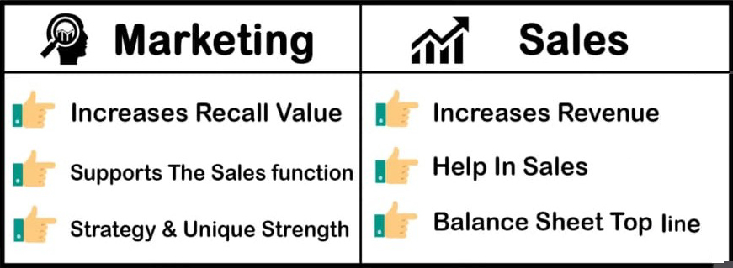
Key points about the "Grow, Solve, Optimize" principle:
Growth Focus:
The initial stage is dedicated to actively acquiring new customers, expanding market share, and increasing overall business volume.
Problem Identification:
Once growth is established, the focus shifts to identifying existing inefficiencies, bottlenecks, or areas where improvements can be made within the operations.
Solution Implementation:
"Solve" involves developing and implementing solutions to address the identified problems, which could include process changes, technological upgrades, or organizational adjustments.
Continuous Improvement:
"Optimize" entails ongoing monitoring and refinement of processes to ensure maximum efficiency and effectiveness, often utilizing data analysis to identify further areas for improvement.
Notes:
The "Grow, Solve, Optimize" principle refers to a strategic approach where a company first focuses on expanding its market reach and customer base ("Grow"), then identifies and addresses key problems or pain points within its operations ("Solve"), and finally, refines processes and procedures to maximize efficiency and effectiveness ("Optimize") - essentially prioritizing growth, problem-solving, and continuous improvement in a sequential manner.
Key points about the "Grow, Solve, Optimize" principle:
Growth Focus:
The initial stage is dedicated to actively acquiring new customers, expanding market share, and increasing overall business volume.
Problem Identification:
Once growth is established, the focus shifts to identifying existing inefficiencies, bottlenecks, or areas where improvements can be made within the operations.
Solution Implementation:
"Solve" involves developing and implementing solutions to address the identified problems, which could include process changes, technological upgrades, or organizational adjustments.
Continuous Improvement:
"Optimize" entails ongoing monitoring and refinement of processes to ensure maximum efficiency and effectiveness, often utilizing data analysis to identify further areas for improvement.
Benefits of using the "Grow, Solve, Optimize" principle:
Sustainable Growth:
By addressing underlying issues while growing, the company can maintain long-term success and avoid potential setbacks caused by operational inefficiencies.
Resource Efficiency:
Identifying and eliminating waste within operations allows for better resource allocation and cost reduction.
Data-Driven Decision Making:
The optimization phase encourages utilizing data to make informed decisions about process improvements.
The Principles of a Successful Optimization Strategy
28 Oct 2020 — An optimization strategy enables you to discover data-backed solutions through testing. It takes the costly guesswork o...
Cro Metrics
Balancing Growth and Optimization: The 4 ImPERAtives of ...
3 Oct 2023 — Balancing Growth and Optimization: The 4 ImPERAtives of Continuous Improvement. ... They provide structure, consistency,
Universal Creative Solutions
Process Optimization Explained - Methods, Benefits & Tools
Process optimization plays a crucial role in ensuring that a company can operate efficiently, maintain high-quality standards in p...
ProcessMaker
Show all

Slide 4
OUR SERVICES: SERVICES Development Business Promotions Trainings and Basic Operations Development Development of applications and websites. Web Development App Development Software Development Business Promotions Digital solutions for better optimization and business growth. SEO / SMO Digital Marketing Social Media Marketing Trainings & Basic Operations We provide Industrial Trainings on live projects. IT Trainings Data Entry Pamphlets & Brochures

Slide 5
To easily grow an IT services startup.
focus on identifying a niche market,
building strong customer relationships through excellent service,
leveraging your network for referrals,
actively seeking partnerships with complementary businesses, and
constantly refining your service offerings based on client feedback;
prioritize building a skilled team and maintaining a flexible approach to adapt to changing market demands.
Key strategies to implement:
Define a clear value proposition:
Highlight what sets your IT services apart from competitors and communicate this clearly to potential clients.
Target a specific niche:
Focus on serving a particular industry or type of client with specialized needs to establish expertise.
Build a strong online presence:
Create a professional website, utilize social Media

Slide 6
The major industries we serve with our high quality service range are:
IT services companies in India primarily serve a wide range of industries including
healthcare,
finance,
retail,
education,
logistics,
manufacturing,
telecommunications, and media
by providing consulting, software development, and outsourcing services across these sectors

Slide 7
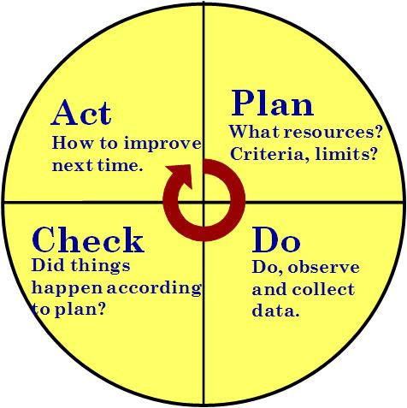

Simple Ways to Reach out to Your Customers:
Know your audience
Provide consistent customer experience
Invest in Content Marketing
Take advantage of customers’ testimonials
Set up a referral program
Stay connected via newsletter
Listen to your customers’ feedback
Demonstrate your products or services

Slide 8
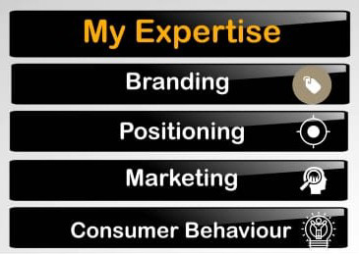
Types of marketing:
Niche Marketing
Trade Show Marketing
Social Media Marketing
Freebie Marketing
Under Cover Marketing
Outbound Marketing & Inbuond Marketing
Cross Promotion

Slide 9
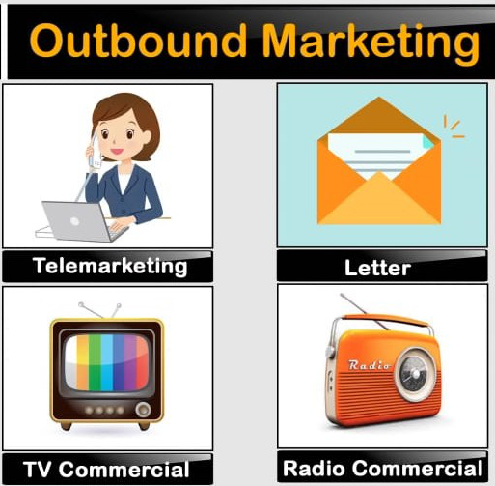

Outbound Marketing & Inbound Marketing:

Slide 10
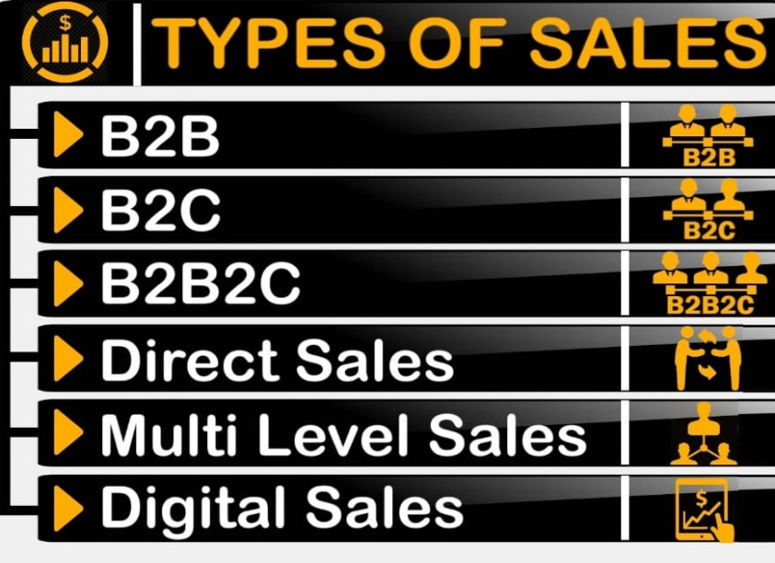
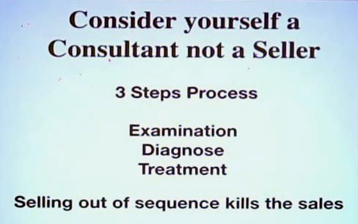
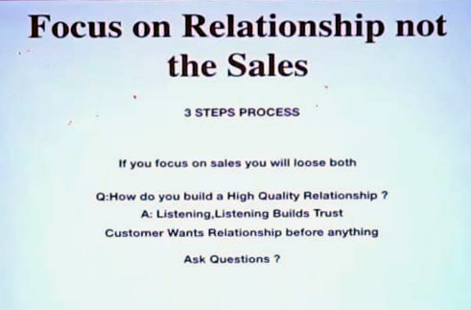

Sales
How to sale a Product ?
3 Step formula

Slide 11

If You Want To Boost Sales….
Focus on the existing customers
Learn about competitors
Innovation and unique products
Cultivate value
Build a customer service approach
Customer relations
Promotion
Marketing

Slide 12

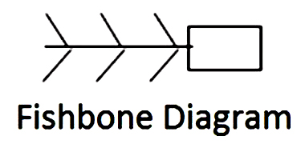
HOW TO GET CLIENTS:
Find clients through your workplace.
Find clients through business organizations.
Tell friends and family you'd like more clients.
Advertise for clients.
Get clients through your personal activities.
Get clients through referrals.
Get clients through social media.

Slide 13
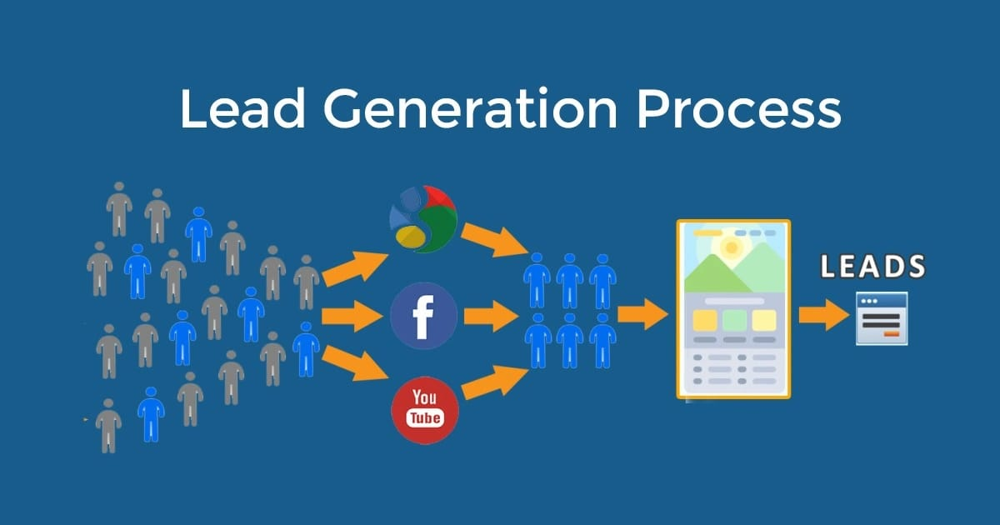
Online Lead Generation Techniques that Works:
Search Engine Optimization
Pay Per Click Advertisement
Lead Generation Website
Online Networking
Webinars
Industry Research Reports
Online Marketing Videos

Slide 14
CERTIFICATIONS
Be Assure
With the assistance of our well equipped infrastructural unit and quality management system, we have earned certifications from different organizations at international level.

